Slide 1


Investigate Handwriting for Identification Using Deep Learning Algorithms Capstone Project Phase 1 Supervisor: Mr. Illya Zeldner
Adi Lampert & Doron Tuchman

Slide 2
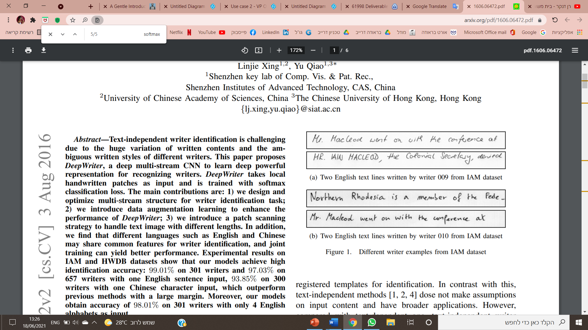
Introduction
♦ Our project addresses the problem of automatic writer identification using scanned image of the author handwrite.
♦The main goal of out project is matching between a given handwrite to specific person's handwrite
♦Our algorithm combine two known algorithms to solve our problem: DeepWrite and AutoEncoder with SIFT.

Slide 3
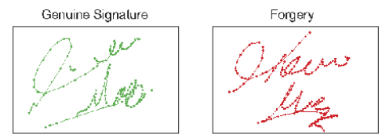
Motivation
There are many areas where handwritten text detection has key impact:
♦ Insurances
♦ Educational institutions
♦ Banking.

Slide 4
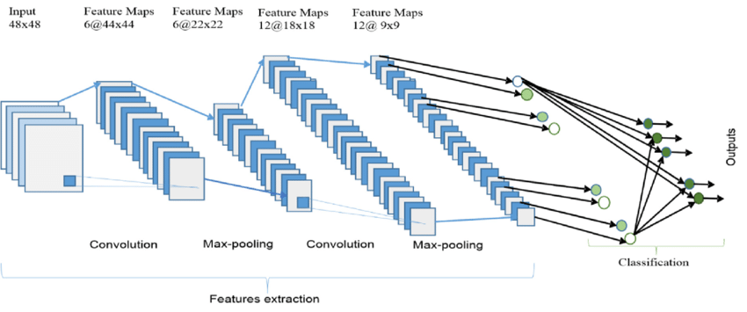
Convolutional Neural Network
We will present the solution for this challenging problem by leverages deep CNNs as a powerful model.
CNN can be thought as a combination of two components:
♦ Feature extraction part ♦ Classification part
CNN contains :
Convolutional layer + filter
ReLU
Pooling layer
Reduces the dimensionality of images by reducing the number of pixels in the output from the previous convolutional layer.

Slide 5
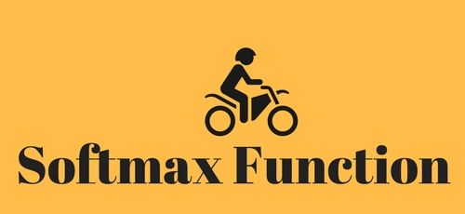
Softmax
♦ Turns a vector of K real values into a vector of K real values that sum to 1.
♦ The input values can be positive, negative, zero, or greater than one.
♦ Softmax transforms the input into values between 0 and 1
Benefit:
The main advantage of using Softmax is the output probabilities range.

Slide 6
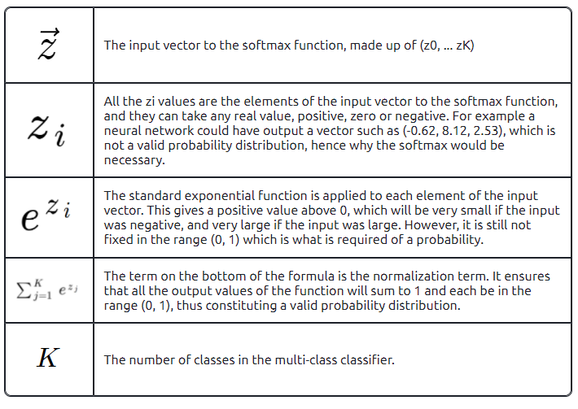
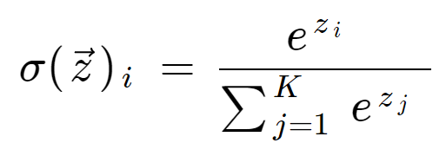

Slide 7
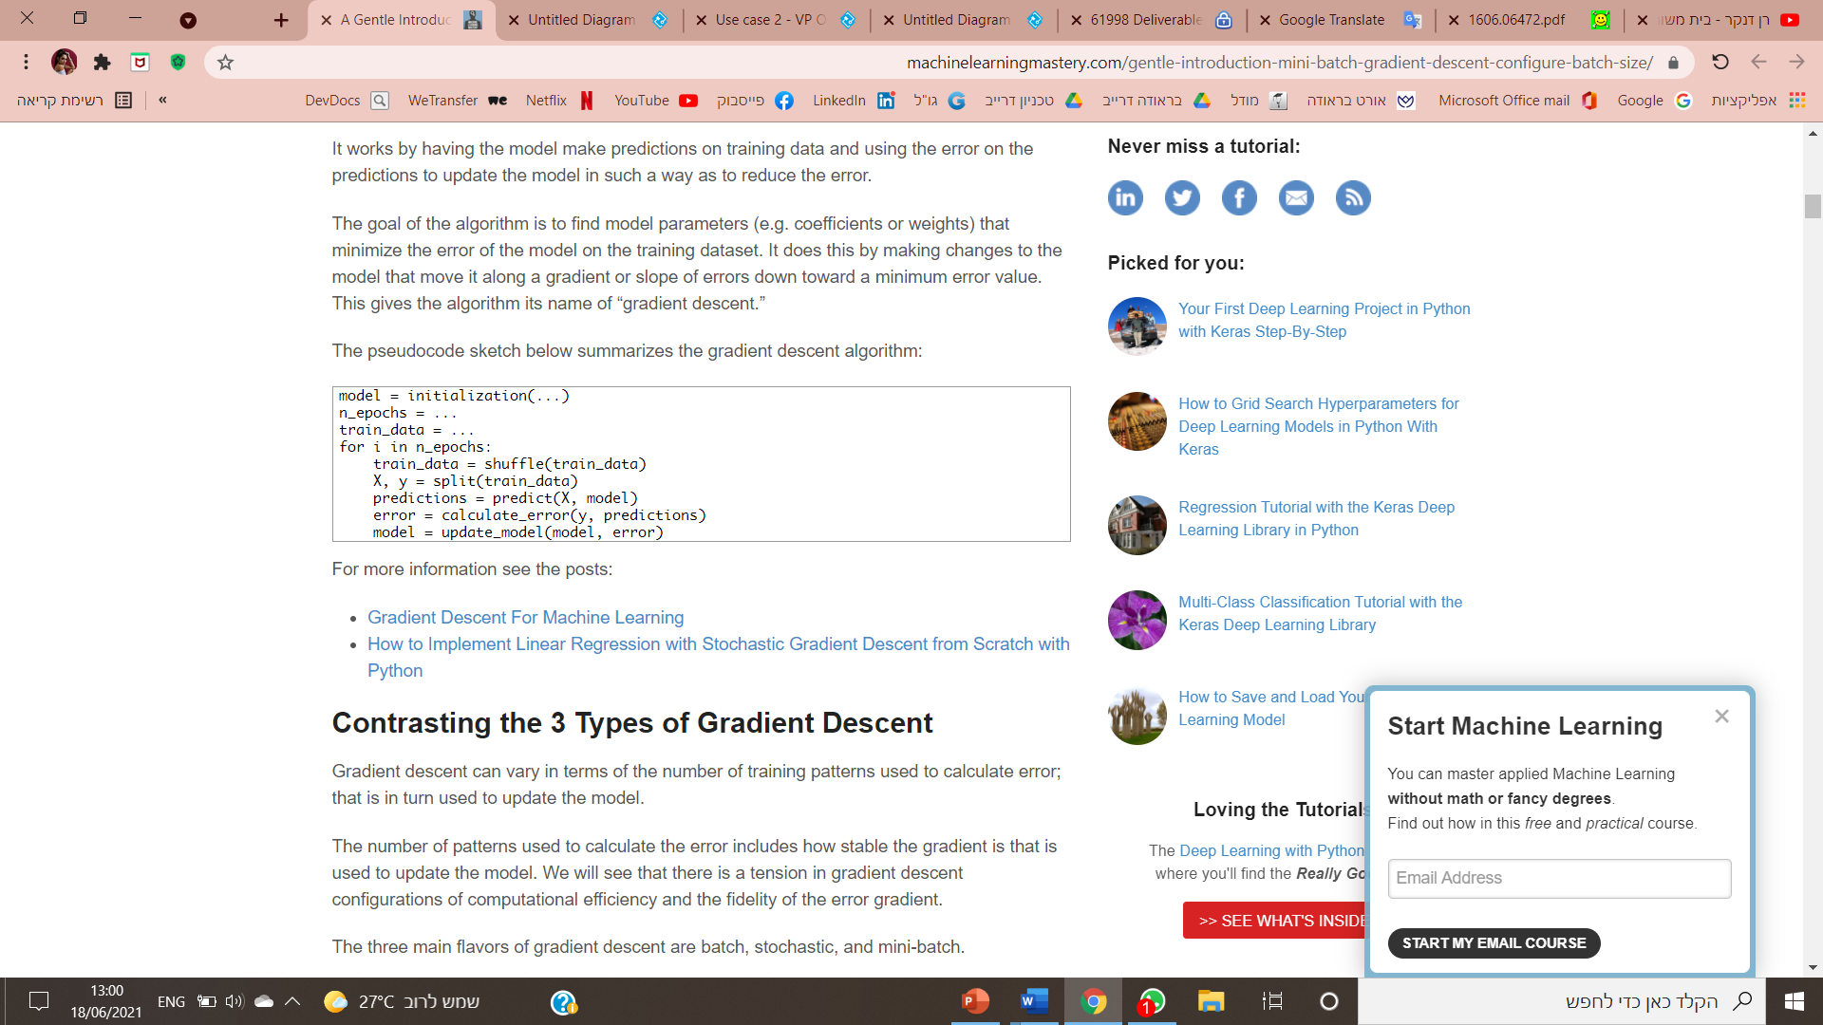
Mini-Batch Gradient Descent
What is the Gradient Descent function ?
♦ Used for finding the weights or coefficients of machine learning algorithms
♦ Make predictions on training data
♦ Using the error on the predictions to update the model in such a way as to reduce the error
Mini-Batch Gradient Descent is a variation of the gradient descent algorithm.
♦ Splits the training dataset into small batches
♦ Used to calculate model error and update model coefficients.

Slide 8
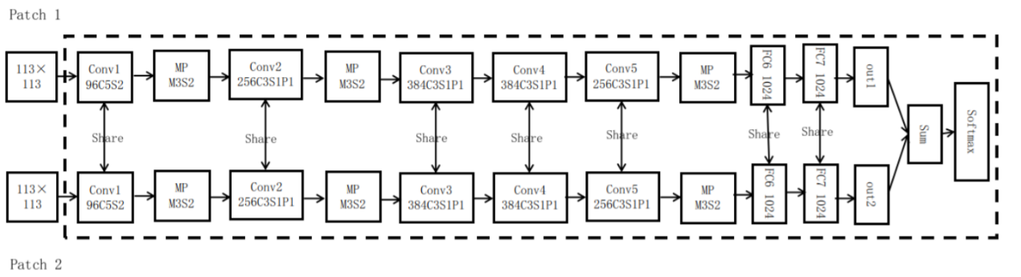
Part 1 - DeepWriter
What is DeepWriter ?
♦ Main purpose is extracting writer sensitive features.
♦ The basic network structure is Half DeepWriter.
♦ DeepWriter takes as input a pair of 113X113 scanned image patches.
We leverage relationship between two adjacent image patches, leading to DeepWriter structure.

Slide 9
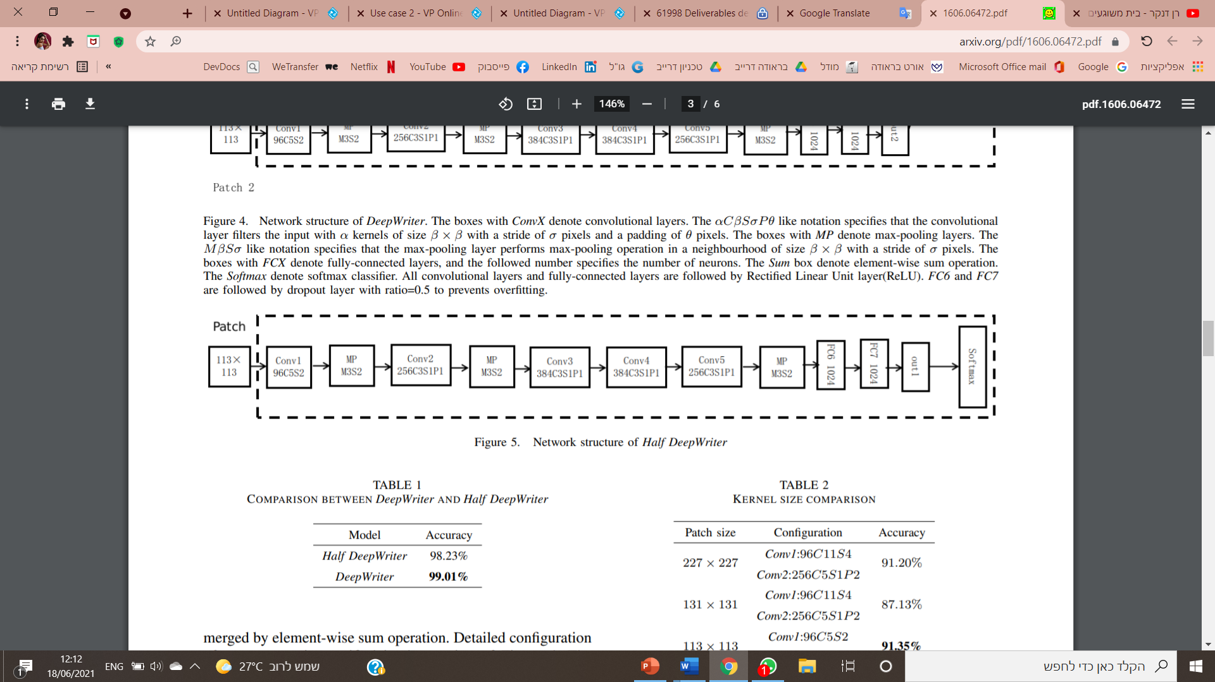
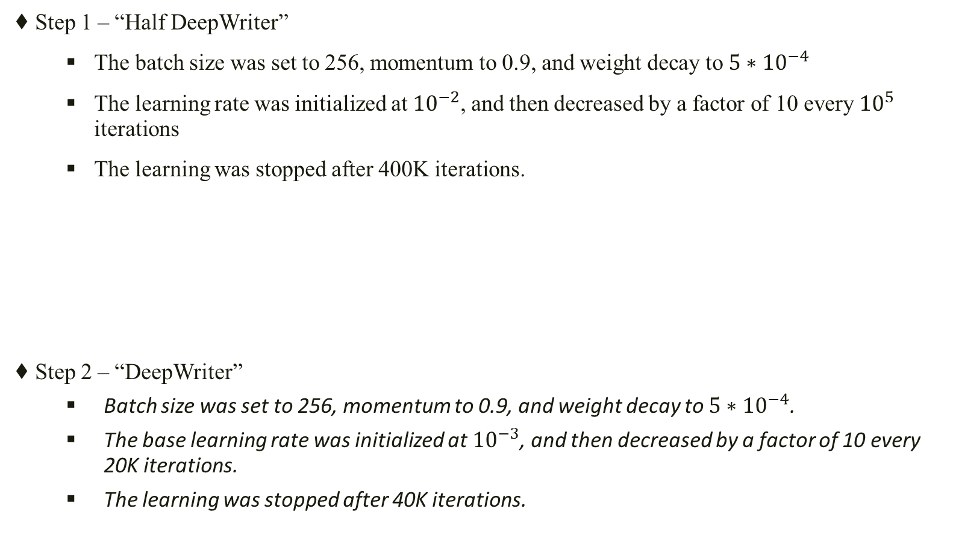
Training process
♦ Step 1 – “Half DeepWriter”
The batch size was set to 256, momentum to 0.9, and weight decay to $5∗{10}^{−4}$
The learning rate was initialized at${10}^{−2}$, and then decreased by a factor of 10 every ${10}^{5}$ iterations
The learning was stopped after 400K iterations.
♦ Step 2 – “DeepWriter”
Batch size was set to 256, momentum to 0.9, and weight decay to $5∗{10}^{−4}$.
The base learning rate was initialized at ${10}^{−3}$, and then decreased by a factor of 10 every 20K iterations.
The learning was stopped after 40K iterations.

Slide 10
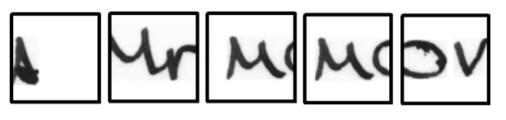
Scanning strategy
Main goal of the scanning strategy is to solve the overfitting problem.
In order to receive 113X113 images, we will perform a few steps:
♦ Resize the scanned image so that min(w,h)=113, while maintaining its aspect ratio
♦ 113×113 image patches are randomly cropped from the resized image.

Slide 11
Convolutional layers and Max-pooing layers
In every stream we have 5 convolutional layers and 3 max-pooling layers.
Convolutional layer contains:
♦ α kernels of size β × β
♦ stride of σ pixels
♦ padding of θ pixels
Max-pooling layer contains:
♦ Max-pooling operation in a neighborhood of size β × β
♦ Stride of σ pixels.

Slide 12
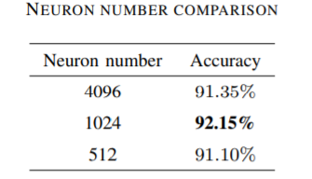
Fully connected layer
♦ Fully connected layer compiles the data extracted by previous layers to form the final output.
Appropriate neuron number reduces the risk of overfitting.
Contrast experiment on validation set:
It was decided to have two fully connected layers with 1024 neurons.

Slide 13
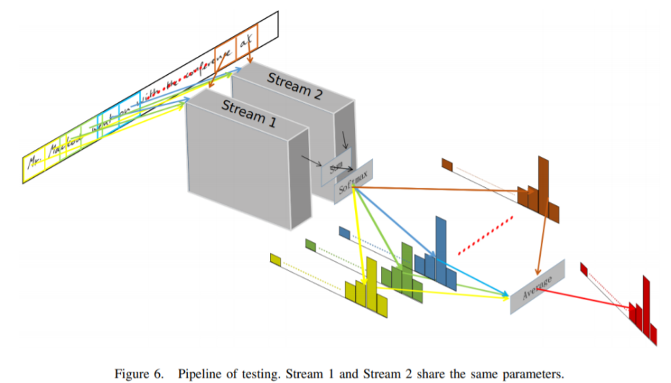
Element wise sum & Softmax & Average
♦ Element wise sum- The vectors output from the last step are merged by element-wise sum operation.
♦Next step is the Softmax function
♦ Next step is average – We do average score vectors of all image patch pairs or image patch to construct the final prediction of input image.

Slide 14
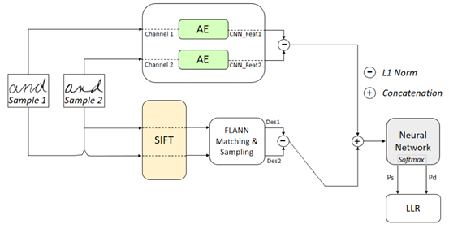
Part 2 – Two channel AutoEncoder with SIFT

Slide 15
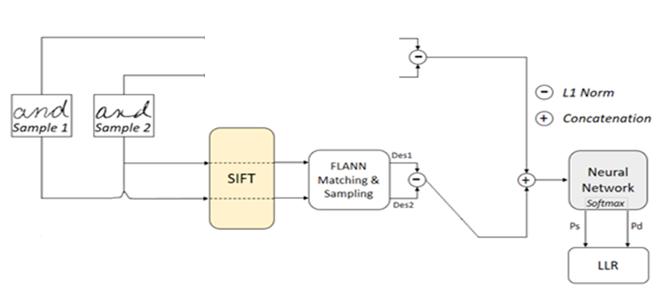
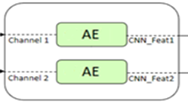
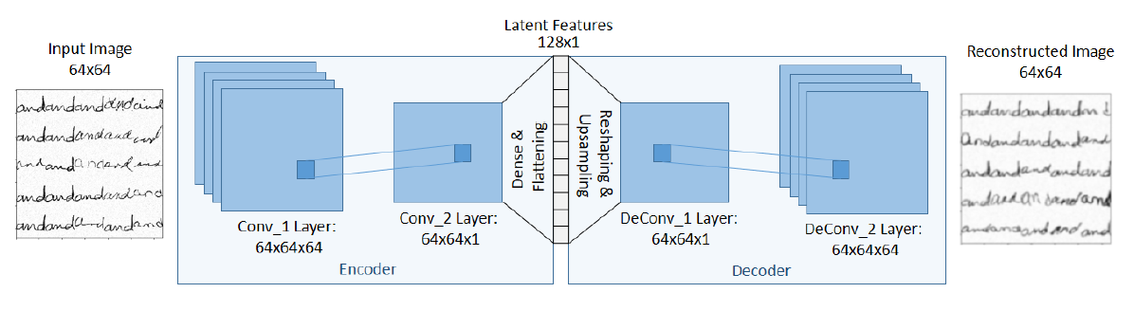
AutoEncoder
♦ Contains Encoder and Decoder
♦ Gets an input image in the size of 64x64
♦ Helps us to extract more robust features from an image
♦ The decoder is used only for the training

Slide 16
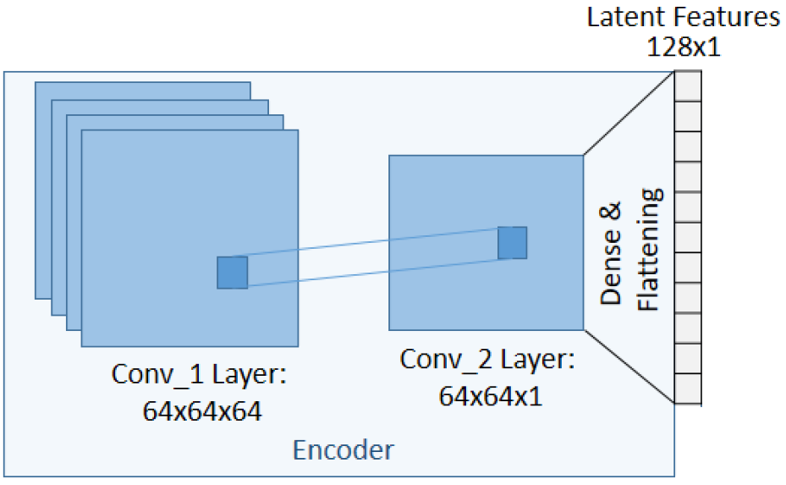
Encoder
The architecture:
♦ Contains two Convolution layers
♦ 3 Fully connected layers (4096, 1024, 128)

Slide 17
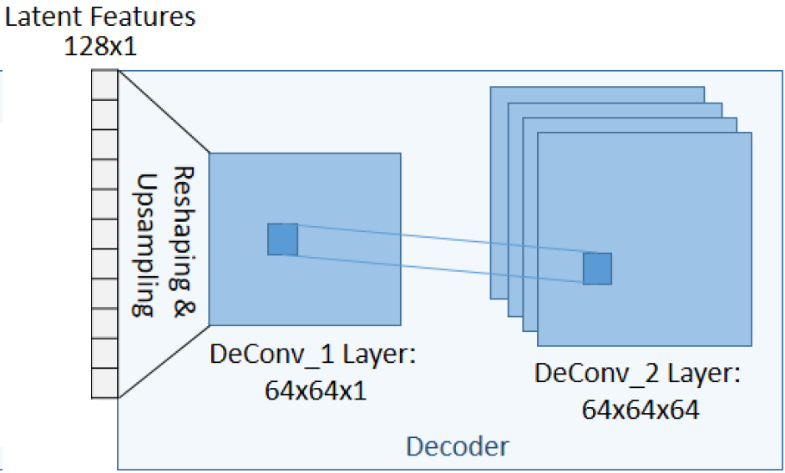
Decoder
♦ Reversed from the encoder
♦ we use Cubic Interpolation to resize the output to 64x64

Slide 18
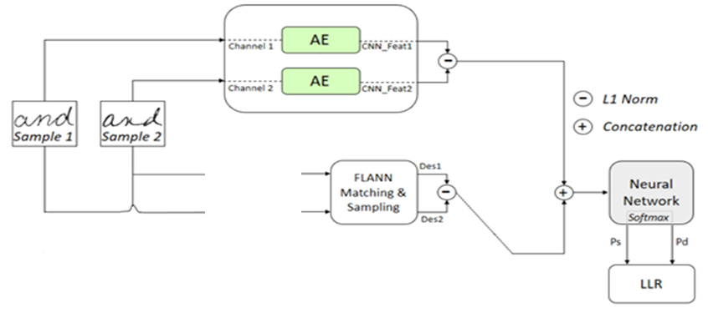
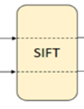
SIFT (Scale Invariant Feature Transform)
Used as handcrafted feature extractor
Captures point level features and comprises of keypoint descriptor
Each keypoint is a result of a stable maxima produced across all the differences of blurred sacles in an octave.
Generates fixed size feature vector

Slide 19
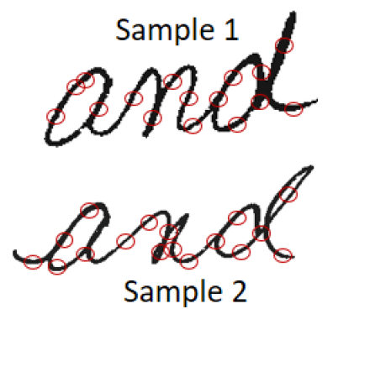
SIFT - Example

Slide 20
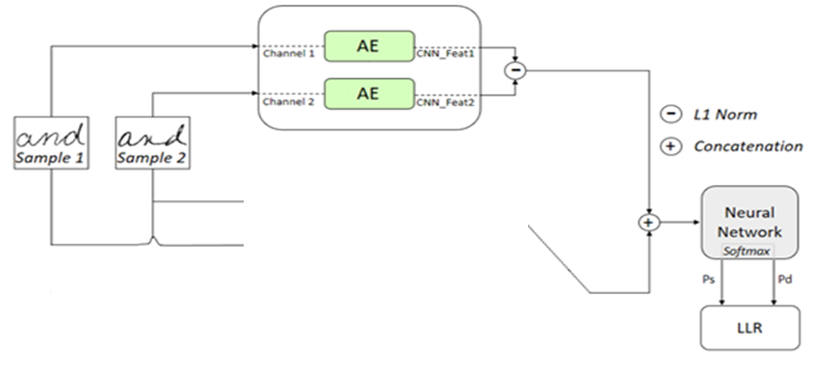
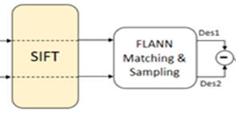
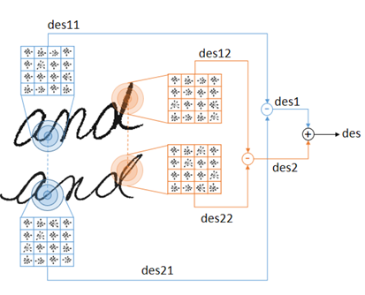
SIFT
Finds keypoints in an image
Creates for each keypoint scale, rotational and orientational invariant image descriptors, each one at the length of 128.
Uses FLANN to match n keypoints
FLANN is a nearest neighbor mapping algorithm

Slide 22
Final Stage
Part 1 – using multi stream algorithm
Part 2 – using AutoEncoder with SIFT
Part 3 – comparing results

Slide 23
Charts & Flow processes
♦Use cases
♦Activity diagram
♦Class diagram
♦Sequence diagram

Slide 24
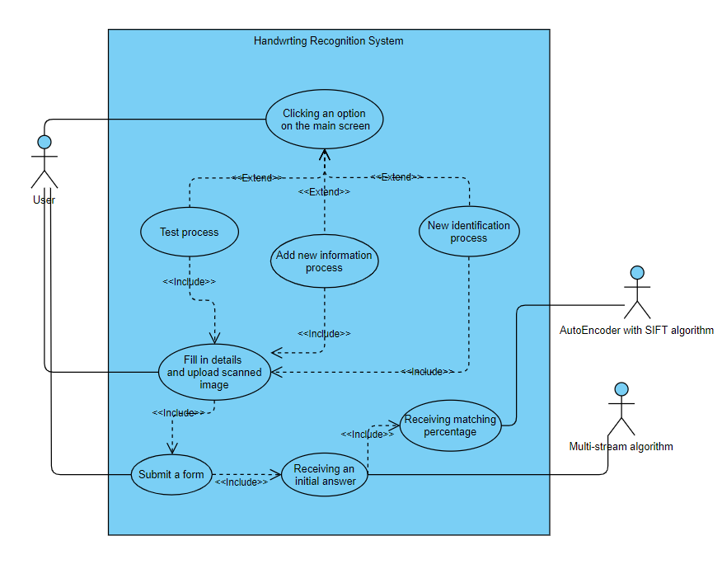
Use case – Handwriting Recognition Algorithm

Slide 25
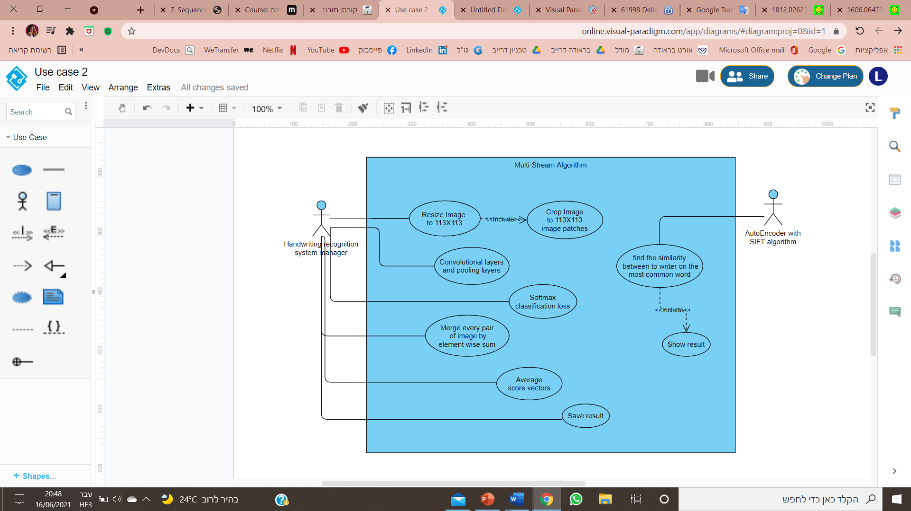
Use case – Multi Stream Algorithm

Slide 26
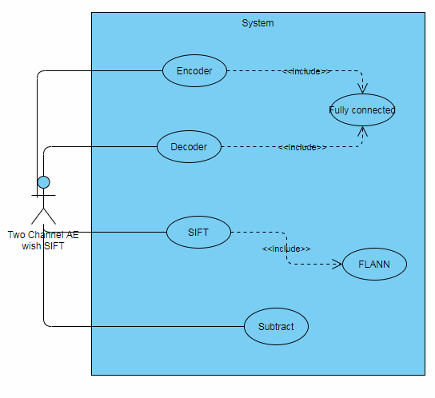
Use case – AutoEncoder with SIFT Algorithm

Slide 27
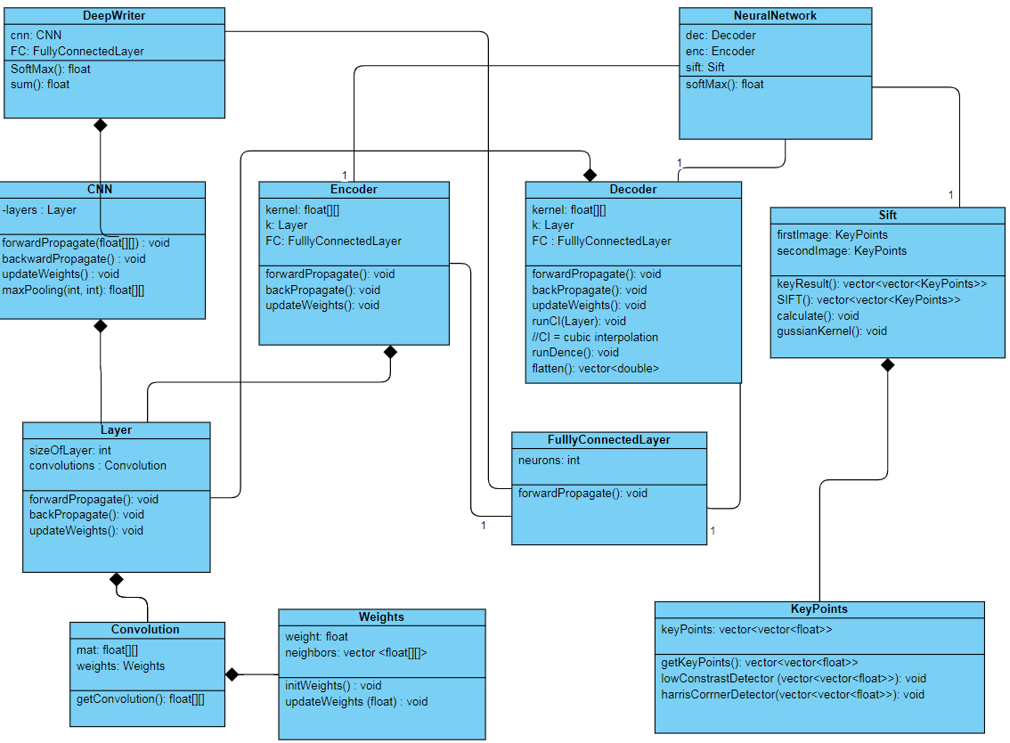
Class diagram -Handwriting Recognition Algorithm

Slide 28
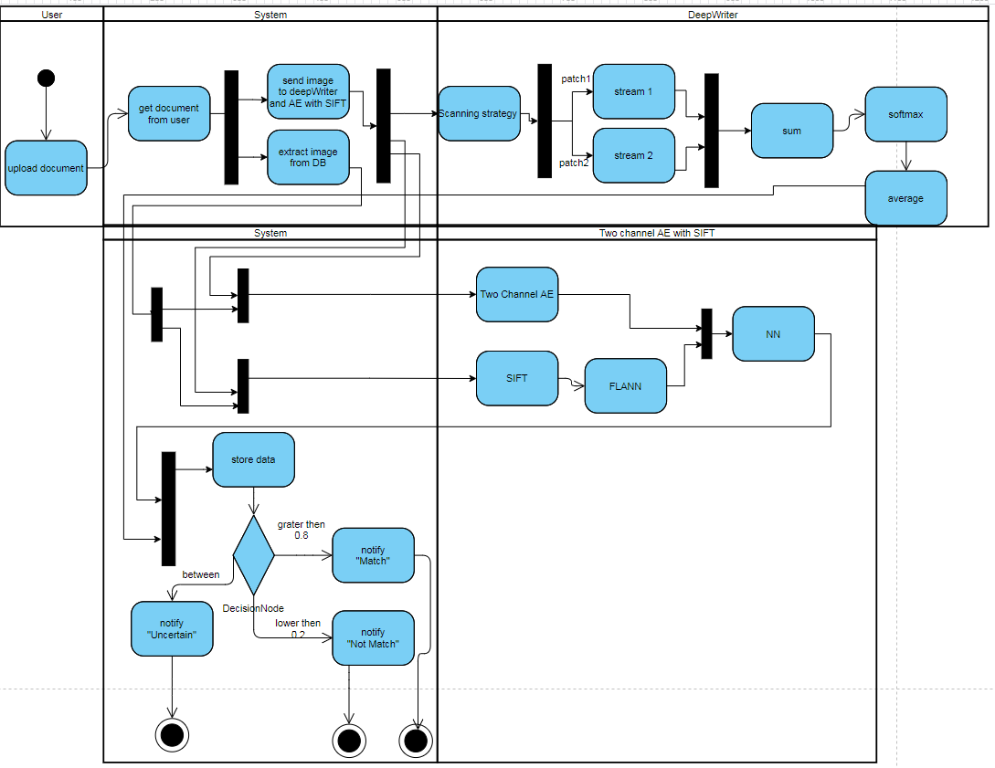
Activity

Slide 29
User interface

Slide 30
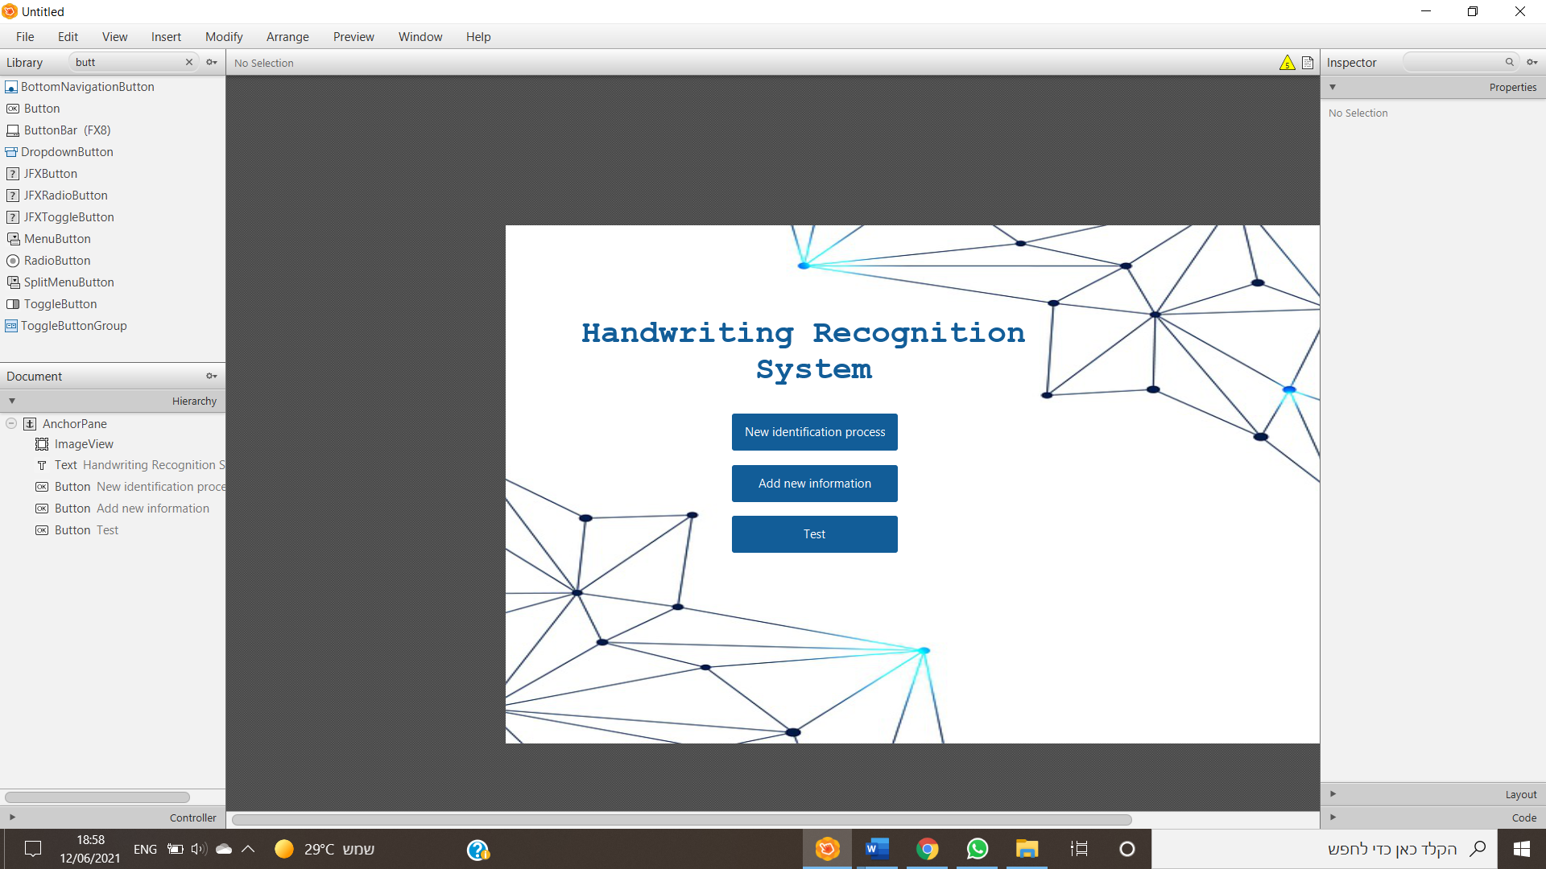
Main screen
3 options to the user

Slide 31
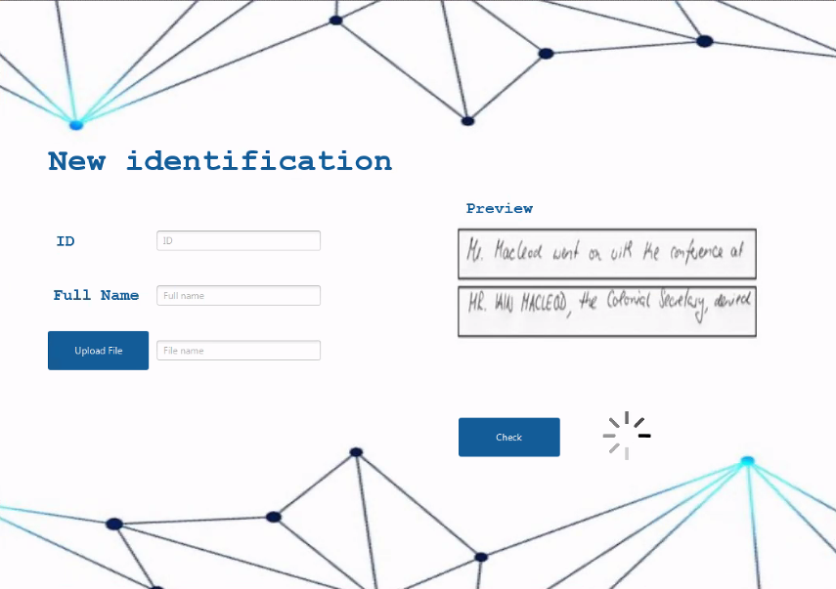
New identification screen
All fields are mandatory
Preview window to display the file.
“Check” button to send the details and file. The system will check if the handwrite belongs to the person.

Slide 32
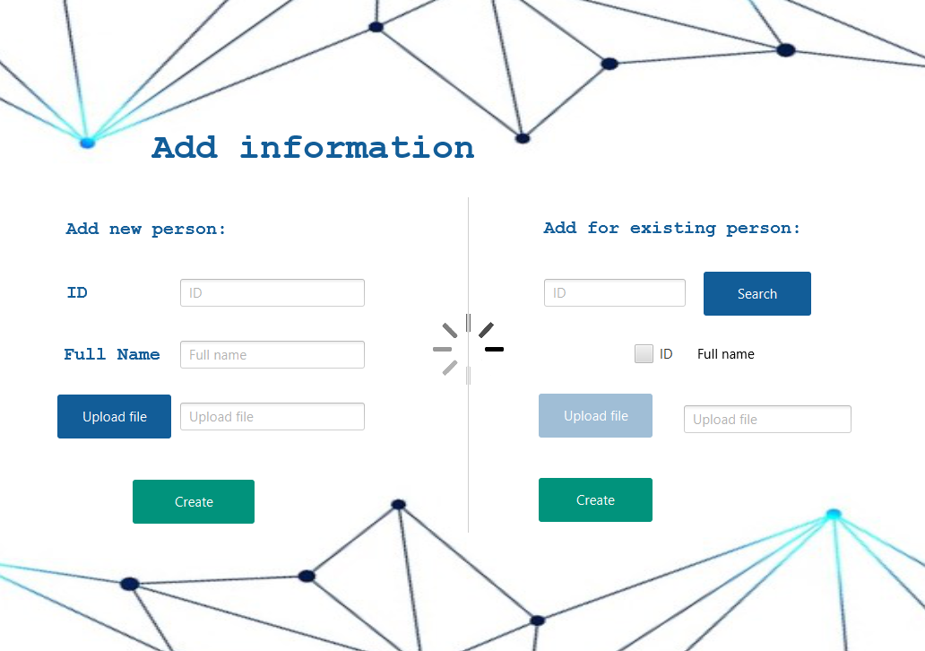
Add new information screen
Add new person:
The user can add a new person to the system by enter his ID, full name, and a scanned image of his handwrite.
“Create” button to send the details and create a new person.
Add for existing person:
The user can search an existing person, then upload a new scanned image.
“Create” button to send the new file and add it to the person.

Slide 33
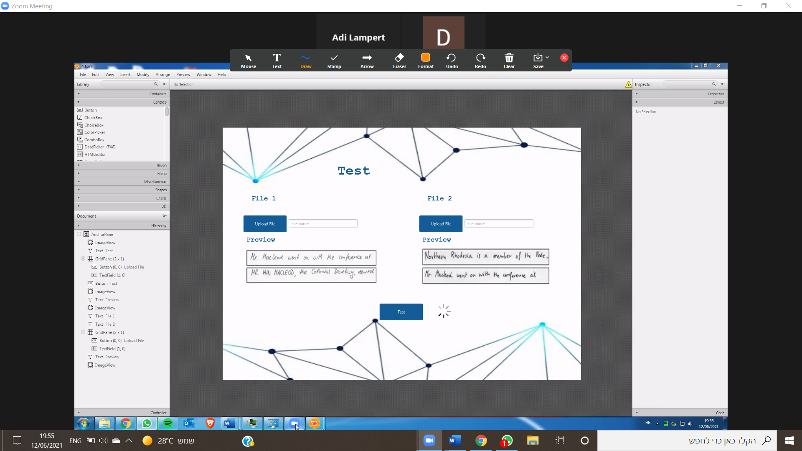
Test screen
The user can upload two files and check if both files belongs to the same person.
Preview window to display the file.
“Test” button to start the test.

Slide 34
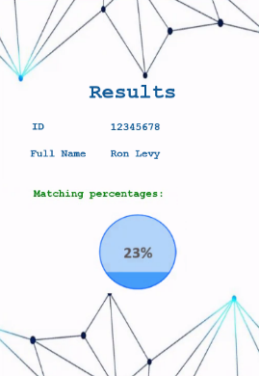
Results screen
In this window the results of “New identification” and “Test” will display here.
The user can see the persons details and the matching percentage.

Slide 35
Test cases

Slide 36
Expected result | Description | Input | Screen | No.
The system will notify to the user that there are no documents for this person | The user tries to start a new identification process to non-exist person | ID: not-exist Full name: not-exist Document: uploaded | New identification | 1
The system will open the "Result" window and display high degree of similarity | The user used the ‘Test’ function and enter two identical documents | Document1: file1 Document2: file1 | Test | 2
The system updates the database | The user tries to upload new document to exist person in the system with legal inputs | ID:123456 Full name: "Yosi Balol" Document: uploaded | Add information | 3
The system will display a message "the person is not-existing" | The user tries to search a non-exist person | ID: not exist | Add information | 4

Slide 37

Thank you !

Slide 38
References
https://deepai.org/machine-learning-glossary-and-terms/softmax-layer
https://cs231n.github.io/convolutional-networks/
https://machinelearningmastery.com/gentle-introduction-mini-batch-gradient-descent-configure-batch-size/
https://www.jeremyjordan.me/autoencoders/
https://towardsdatascience.com/a-comprehensive-guide-to-convolutional-neural-networks-the-eli5-way-3bd2b1164a53
https://corporatefinanceinstitute.com/resources/knowledge/other/overfitting/

